Slide 1
Medical Appointment No-Shows
Analysis and Recommendation
Group 3: Zain Khan, Mahfuzur Rahman, Juan Felipe Gonzalez, Stephen Guto, Dan Okeyo
Notes:
Hello everyone, thank you for joining us today. We’re here to present our analysis on medical appointment no-shows and provide actionable recommendations to address this issue. Our group, consisting of Zain Khan, Mahfuzur Rahman, Juan Felipe Gonzalez, Stephen Guto, and Dan Okeyo, has thoroughly analyzed the data to help identify factors that contribute to no-shows and propose strategies to improve appointment attendance

Slide 2
Business Case
Objective: Build a predictive model to identify patients who are more likely to miss their medical appointments, using factors like age, gender, health conditions, SMS reminders, and scheduling details.
The healthcare industry suffers from a common issue of patients failing to attend scheduled appointments, known as "no-shows." This problem significantly affects healthcare providers and facilities by causing inefficiencies, resource wastage, and loss of revenue.
Missed appointments lead to unutilized time for medical staff while also preventing other patients from receiving timely care.
Additionally, healthcare organizations are financially impacted by the reduction in patient turnover, which lowers the overall revenue stream.
Dataset: https://www.kaggle.com/datasets/joniarroba/noshowappointments
Notes:
Read the slide in your own words

Slide 3
Data Exploration
Rows: 110,527 (represents medical appointments)
Columns: 14 (associated variables)
Target Variable: ‘No-show’
Yes = did not show up
No = showed up
Notes:
To begin, we conducted an exploratory data analysis to understand the structure of our dataset. Key variables included patient demographic information, health conditions, and appointment-related data. We paid special attention to factors like age, chronic conditions, and appointment times to see how they might relate to the likelihood of a patient missing their appointment. Read the slide

Slide 4
Data Dictionary
Coloumn | Description
PatientId | Unique identifier for each patient.
AppointmentID | Unique identifier for each appointment.
Gender | The gender of the patient (F for female, M for male).
ScheduledDay | The date and time the appointment was scheduled.
AppointmentDay | The date of the actual appointment.
Age | The age of the patient.
Neighbourhood | The location of the hospital.
Scholarship | Indicates whether the patient is enrolled in the welfare program (0 = No, 1 = Yes).
Hipertension | Indicates if the patient has hypertension (0 = No, 1 = Yes).
Diabetes | Indicates if the patient has diabetes (0 = No, 1 = Yes).
Alcoholism | Indicates if the patient is an alcoholic (0 = No, 1 = Yes).
Handcap | Indicates if the patient has a handicap (0 = No, 1 = Yes; note that this column may need clarification on values).
SMS_received | Indicates if the patient received an SMS reminder (0 = No, 1 = Yes).
No-show | The target variable, indicating whether the patient showed up for their appointment (No = showed up, Yes = did not show up).
Notes:
Here, we summarize the key variables we analyzed. These include patient-specific information such as age, gender, and medical conditions like diabetes and hypertension. Appointment-related variables included scheduled time, waiting time, and the presence of SMS reminders. Having a clear understanding of these variables was crucial for developing our model and interpreting our results accurately.
Read out each variable and description

Slide 5
Model Approaches
Model | Precision | Recall | F1-score | Accuracy | AUC
Logistic Regression | 0.71 | 0.80 | 0.72 | 0.79 | 0.66
Decision Tree | 0.74 | 0.74 | 0.74 | 0.74 | 0.59
Random Forest | 0.76 | 0.80 | 0.75 | 0.80 | 0.74
Notes:
We tested several models to predict no-shows, including logistic regression, decision trees, and random forests. Each model was evaluated based on accuracy and AUC, allowing us to see how well each approach could separate no-show patients from those who attend their appointments. Through this, we could determine which model would perform best for our needs

Slide 6
Model Comparison
Model | Accuracy | AUC
Logistic Regression | 0.79 | 0.66
Decision Tree | 0.74 | 0.59
Random Forest | 0.80 | 0.74
Best Model Based on Accuracy: Random Forest
Best Model Based on AUC: Random Forest
Notes:
Our model comparison revealed that the Random Forest model had the highest accuracy and AUC score, making it the most effective model for predicting no-shows in this dataset. This model’s ability to handle complex relationships between features made it particularly suitable for our data, which included both patient health conditions and appointment-specific variables.

Slide 7
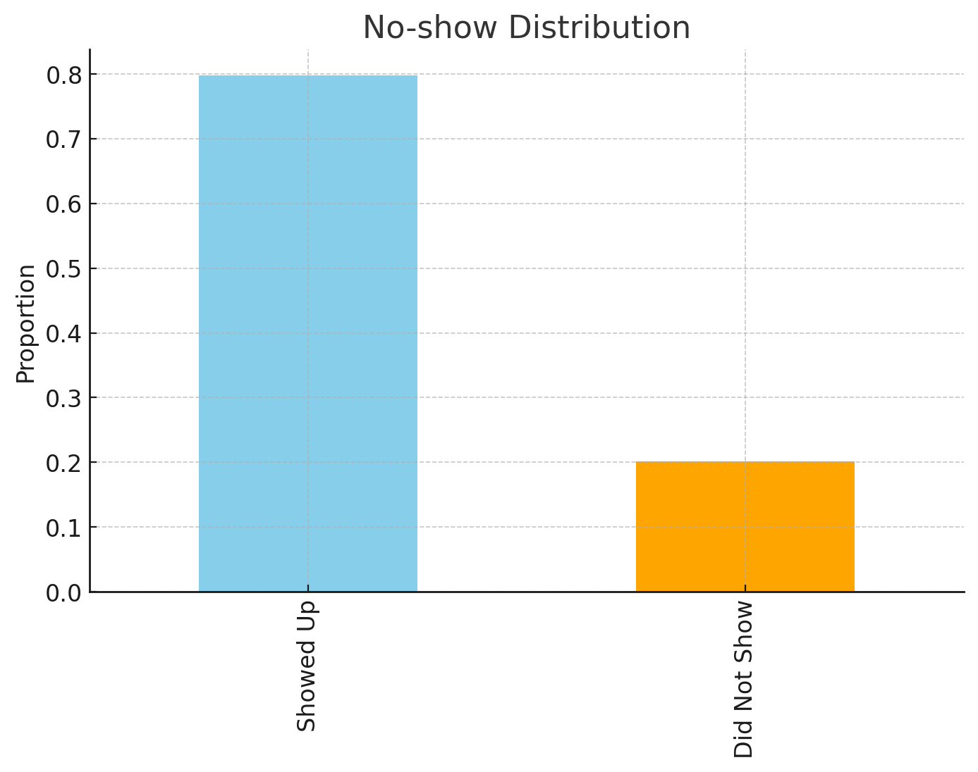
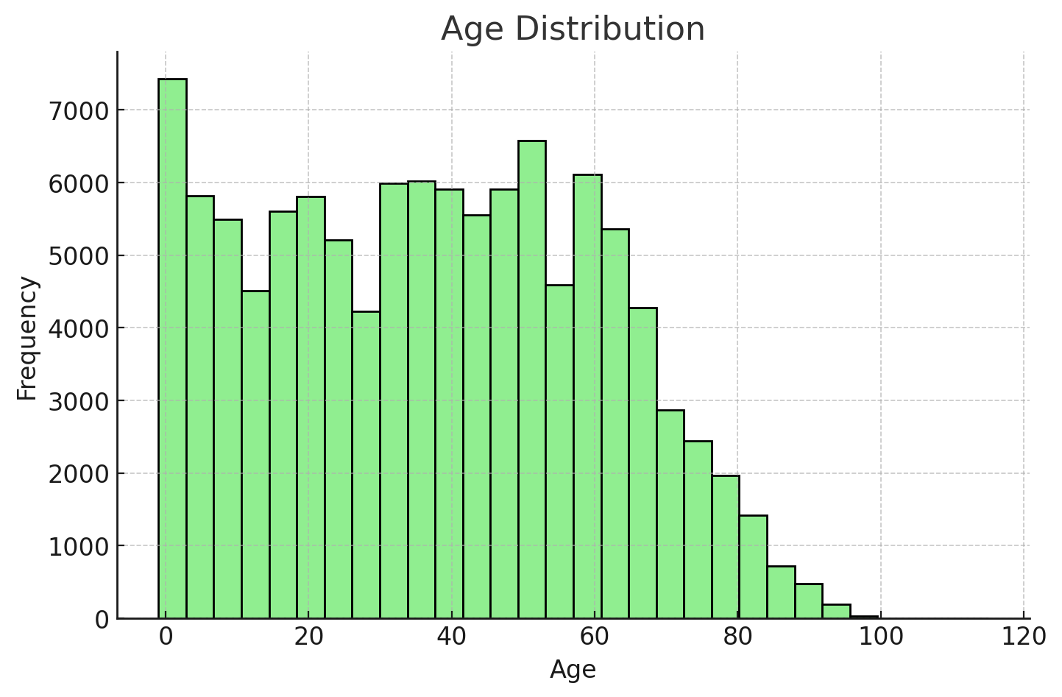
Data Visualization and Insights
Notes:
We visualized key insights from the data to better understand patterns in no-shows. For example, we found that younger patients and patients without chronic conditions were more likely to miss appointments. Additionally, waiting times seemed to influence attendance rates, with longer waits correlating with higher no-show rates. Visualizing these insights helped us identify potential areas for targeted interventions

Slide 8
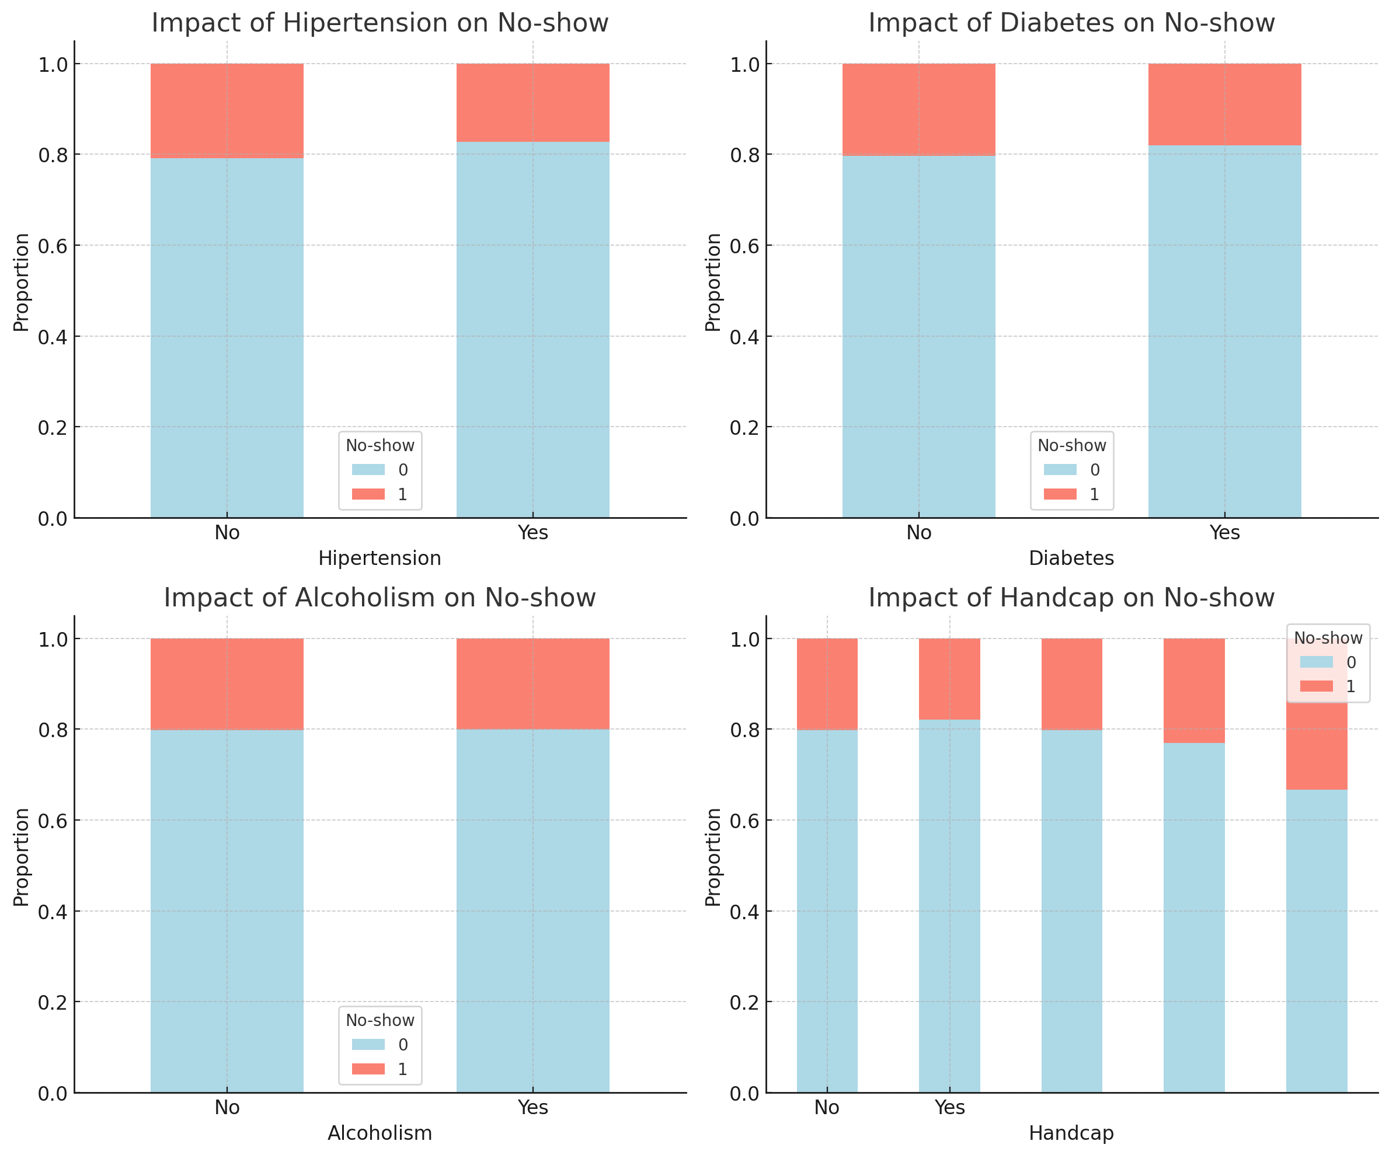
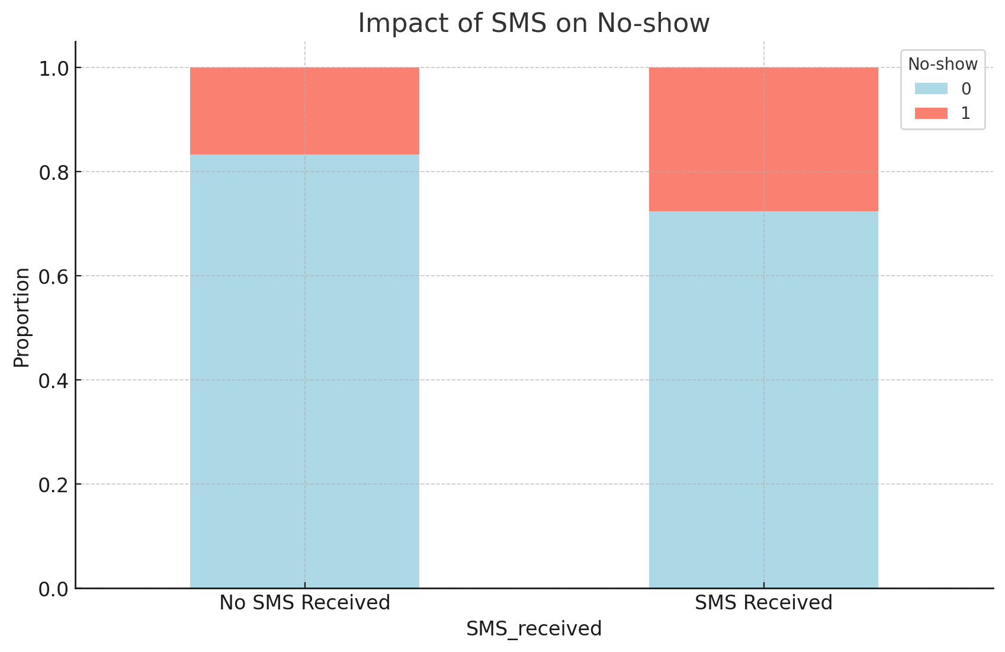
Data Visualization and Insights
Notes:
This slide further breaks down our visual findings, such as the relationship between reminders and attendance. Patients who received SMS reminders were likelier to attend their appointments, highlighting the potential of communication strategies in reducing no-show rates. Insights like these guided our recommendations, as we’ll discuss next.

Slide 9
Next Steps and Recommendations
Targeted Interventions: Focus on high-risk groups, such as patients with severe handicaps or chronic illnesses (e.g., diabetes), for proactive follow-up (e.g., additional reminders or calls).
Enhanced Communication: Increase the use of SMS reminders and possibly experiment with more frequent reminders, especially for patients who have a history of missing appointments or belong to high-risk groups.
Flexible Scheduling for Vulnerable Patients: Offer more flexible or convenient appointment times for patients with higher levels of handicap to reduce barriers to attending appointments.
Notes:
Based on our findings, we propose several targeted interventions. First, we should focus on high-risk groups, such as patients with severe handicaps or chronic illnesses, and provide additional reminders or follow-up calls. Enhanced communication strategies, like SMS reminders, should be expanded, especially for patients with a history of no-shows. Finally, offering flexible scheduling options for vulnerable patients, particularly those with physical handicaps, could reduce barriers and improve attendance rates

Slide 10
Future Exploration and Conclusion
Future Exploration: Investigate the impact of external factors (e.g., weather, distance to the clinic) by incorporating additional data sources that might affect a patient's likelihood of attending appointments.
Conclusion: Predictive modelling can significantly improve healthcare efficiency by identifying patients likely to miss appointments. By focusing on key risk factors such as handicap status and using reminders effectively, clinics can reduce no-show rates and enhance overall patient care.
Notes:
In the future, exploring additional patient data, such as transportation access or employment status, could further refine our model’s accuracy. Overall, our analysis highlights that targeted communication and scheduling flexibility are key strategies in reducing appointment no-shows. Implementing these recommendations can lead to more efficient use of healthcare resources and better patient outcomes. Thank you for your attention, and we’re happy to take any questions.

